Slide 1
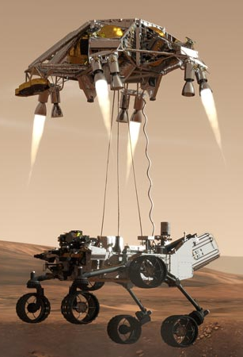
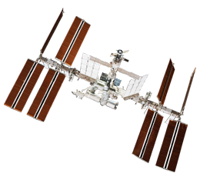
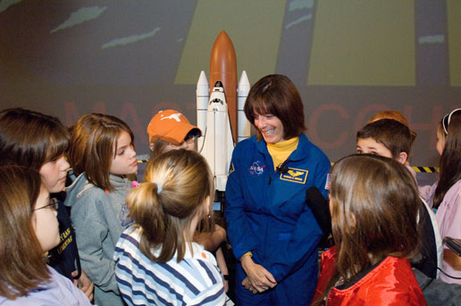
Educator Resources in Space Sciences
Caitlin Nolby and Marissa Saad
North Dakota Space Grant Consortium

Slide 2
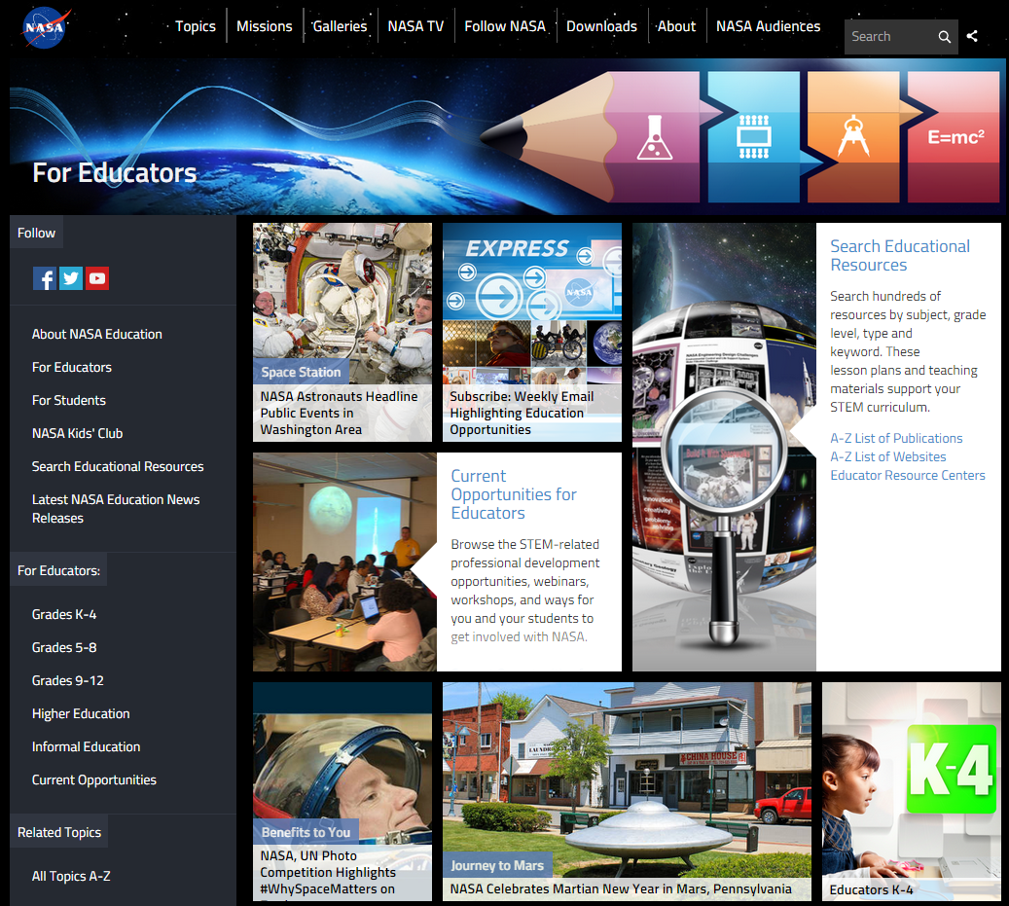
NASA Education

Slide 3
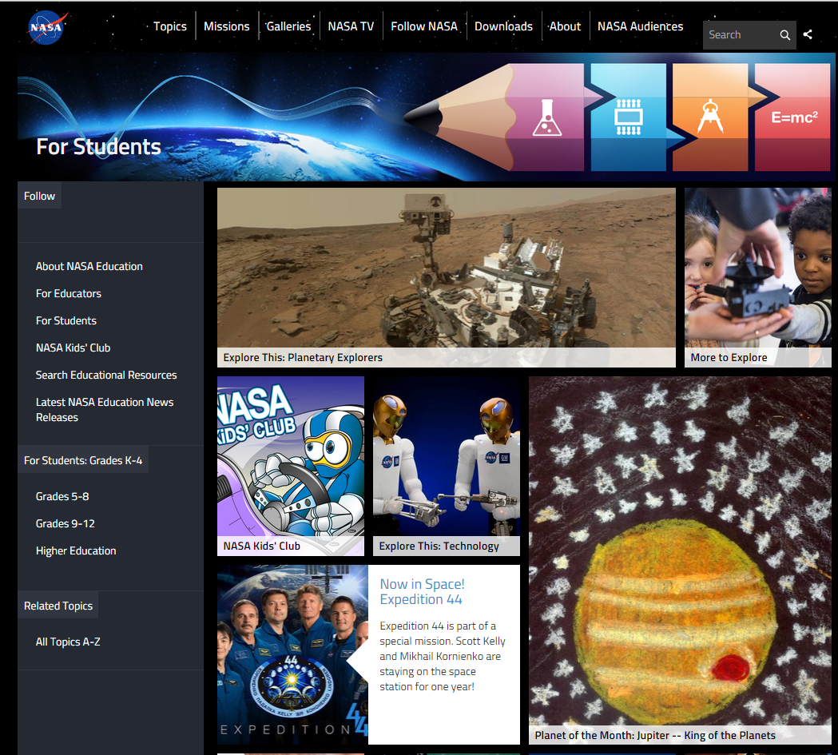
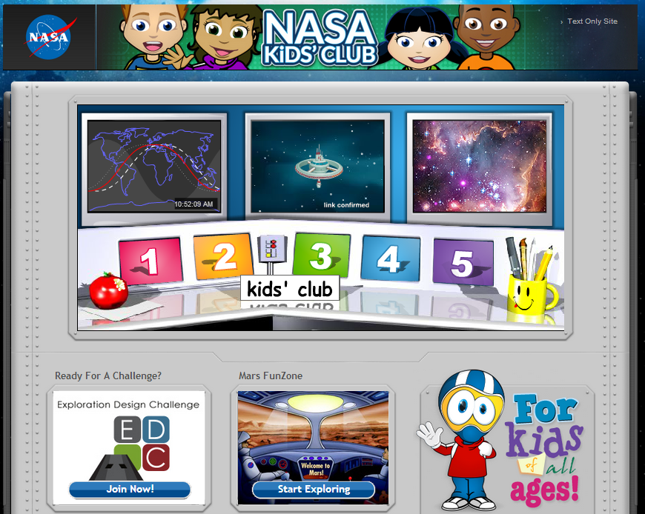
NASA for Students

Slide 4
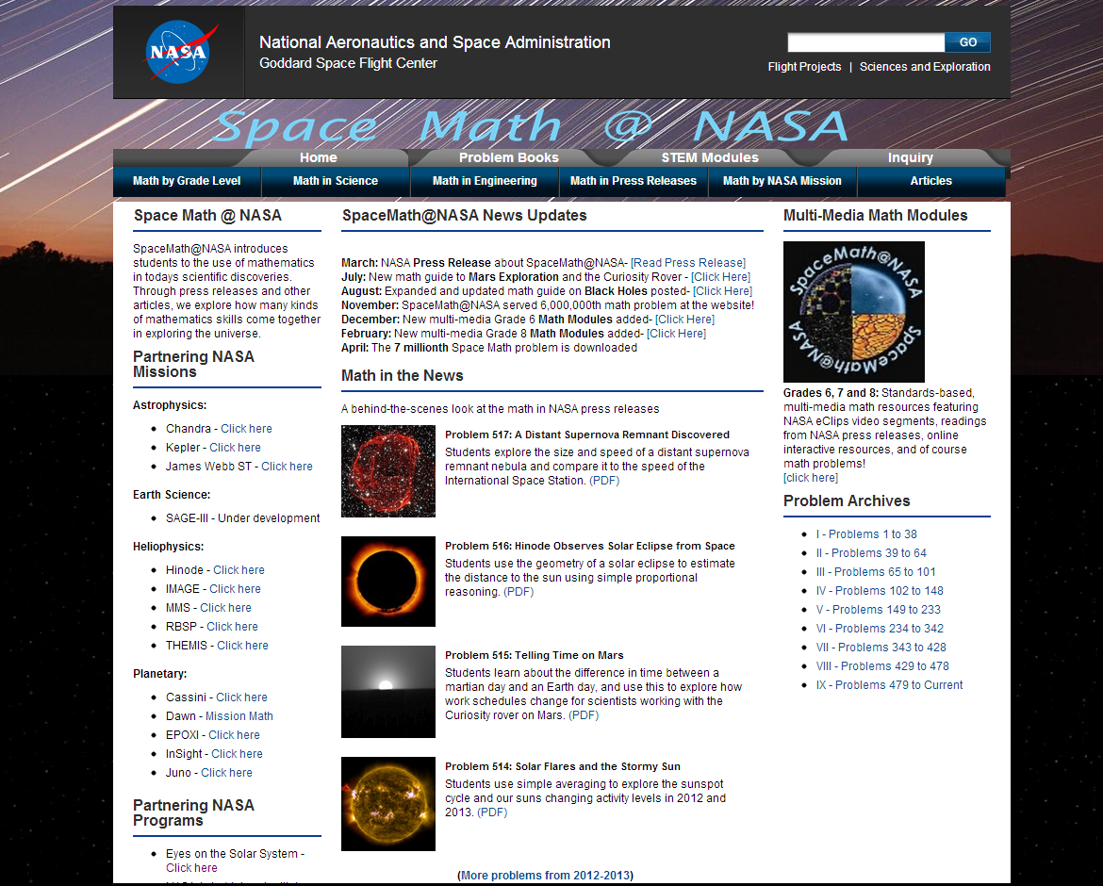
Space Math at NASA

Slide 5
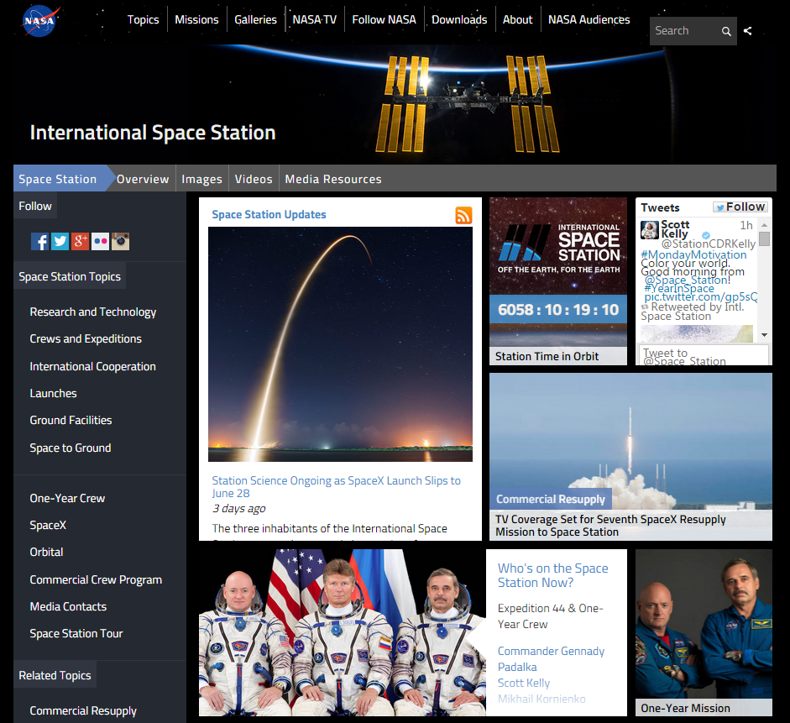
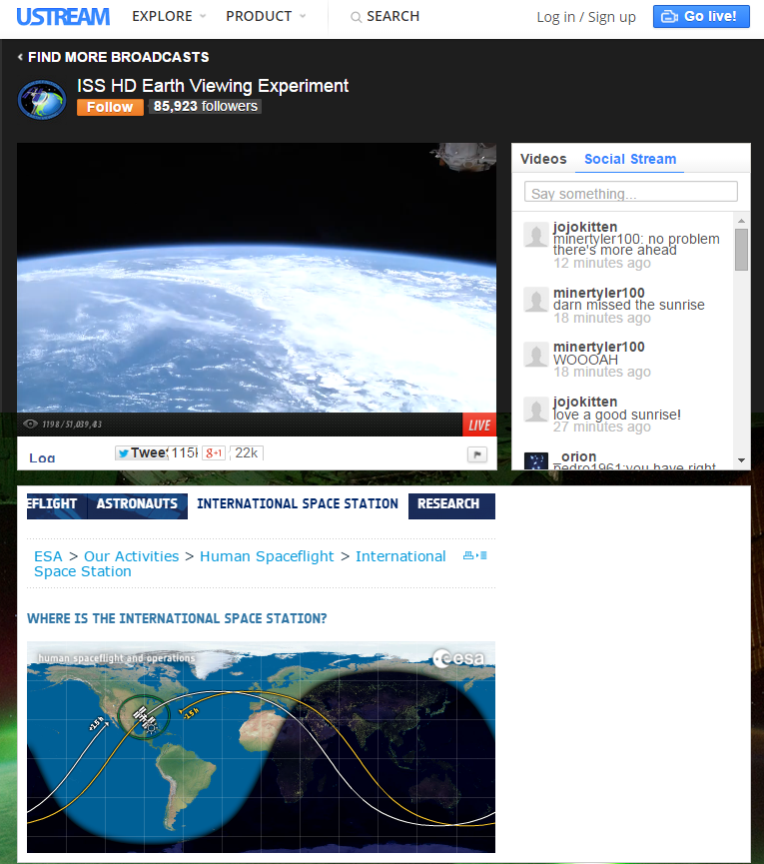
International Space Station - Live!

Slide 6
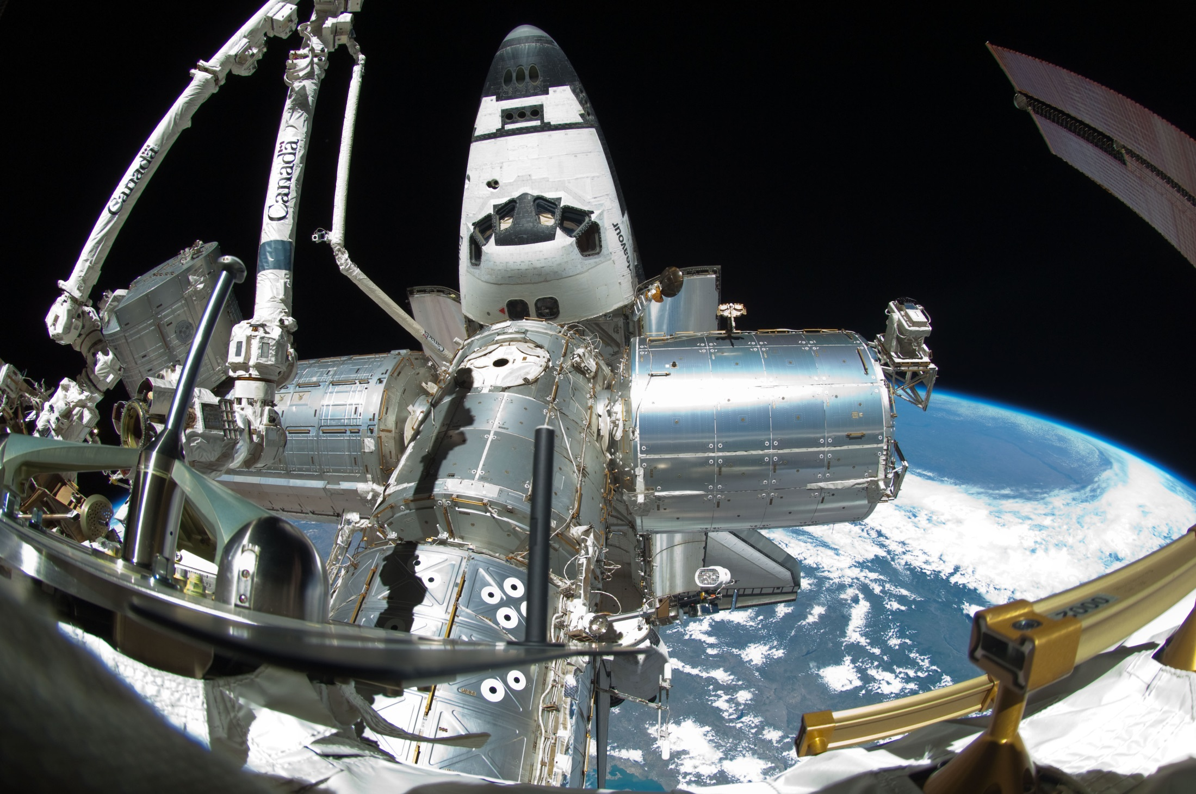
Spot the Station

Slide 7
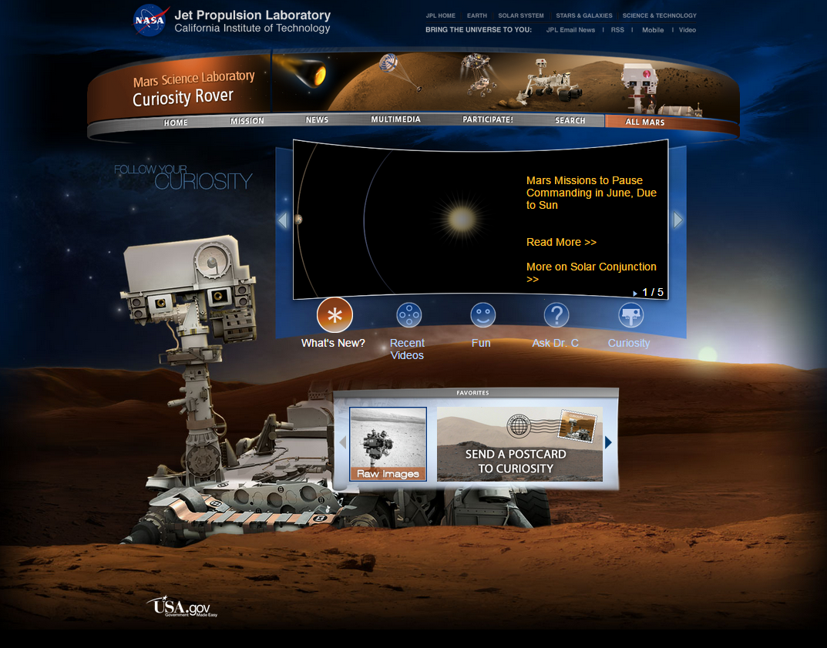
Mars Curiosity Rover

Slide 8
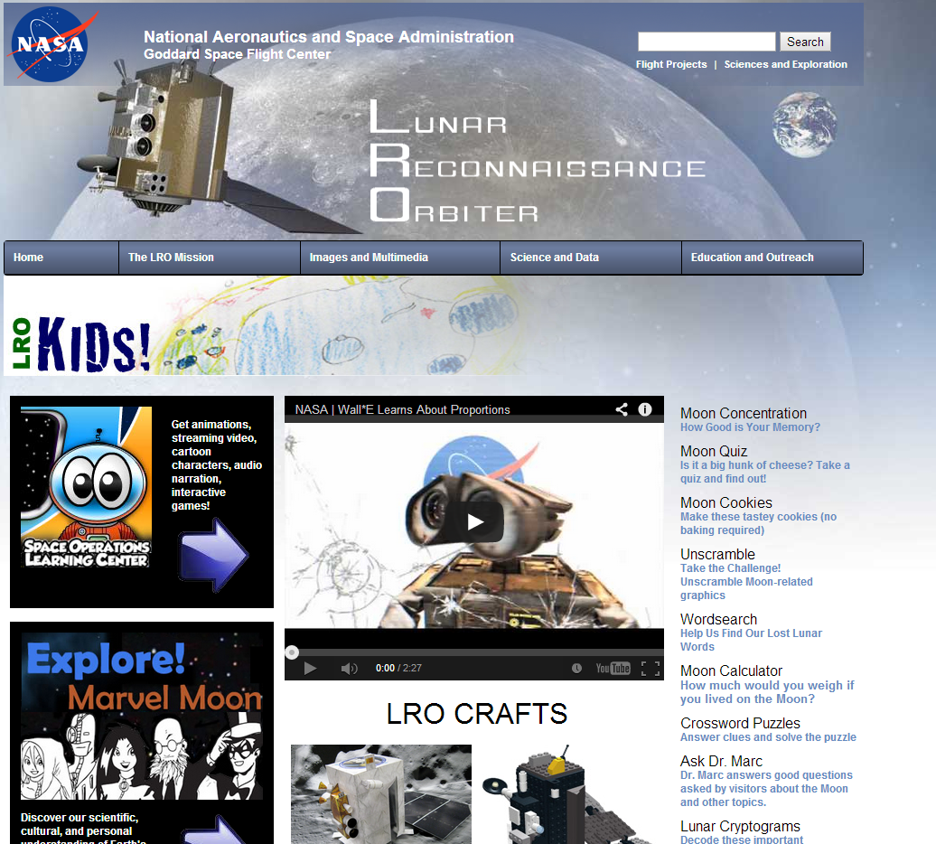
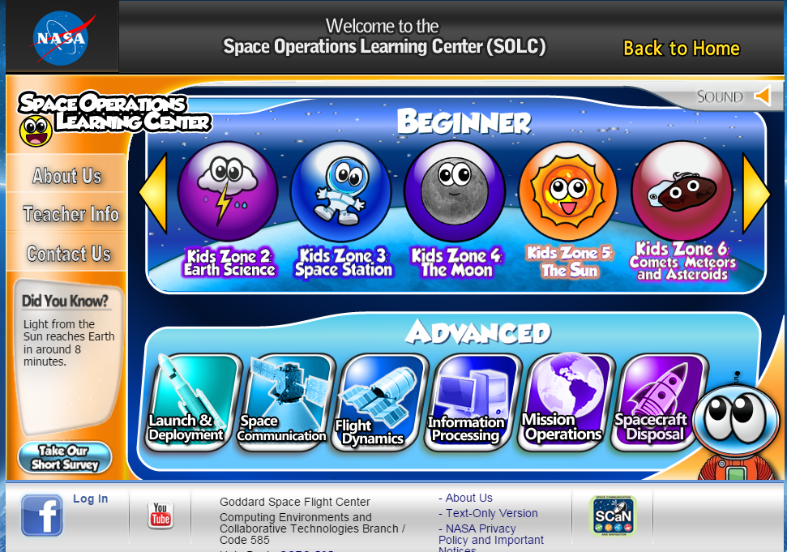
NASA – Lunar Reconnaissance Orbiter

Slide 9
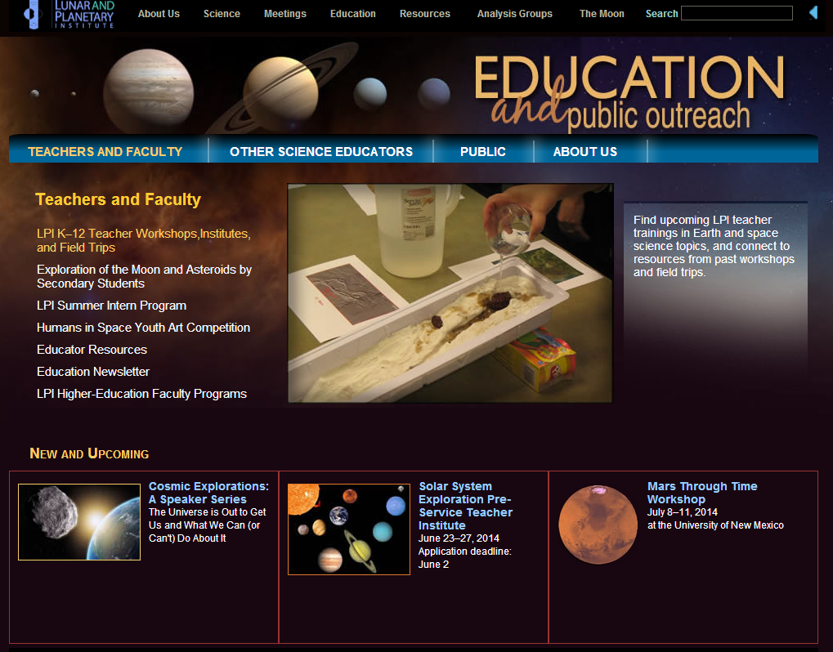
Lunar and Planetary Institute

Slide 10
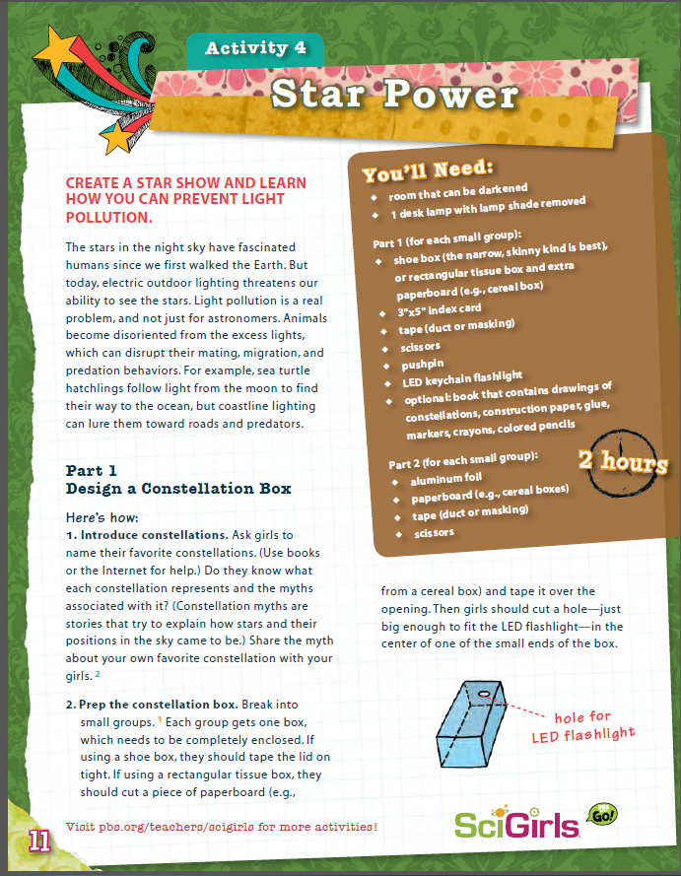
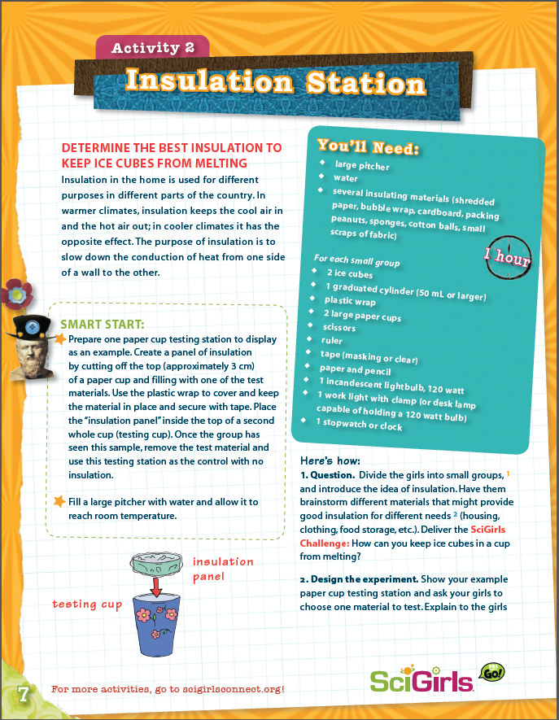
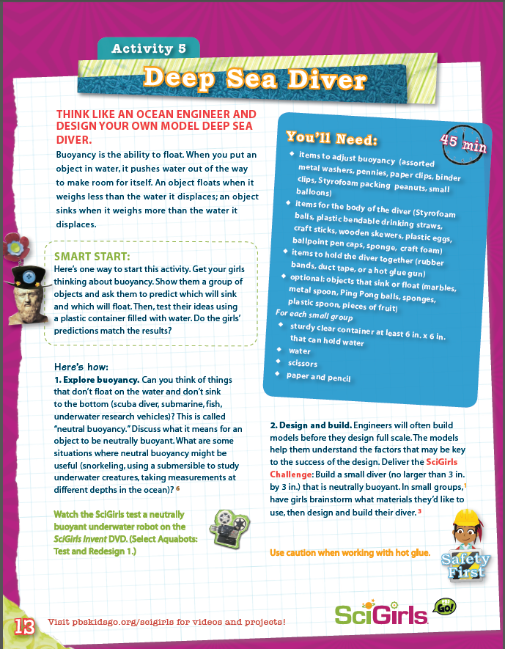
SciGirls Activities

Slide 11
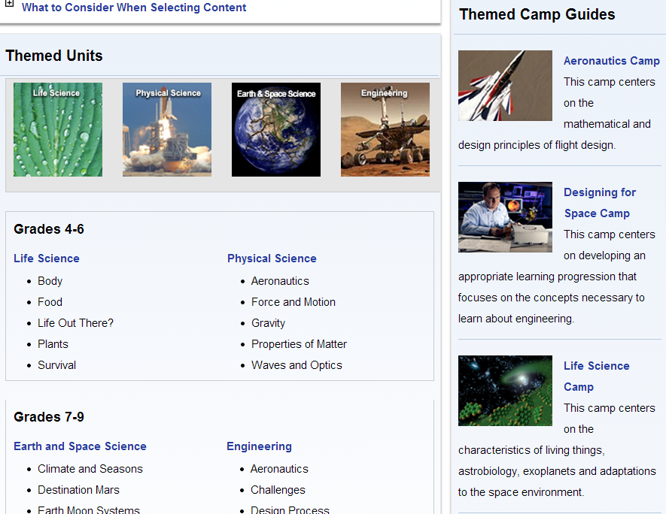
NASA Summer of Innovation

Slide 12
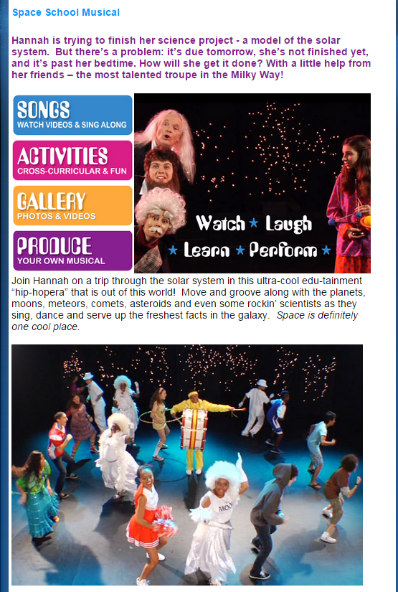
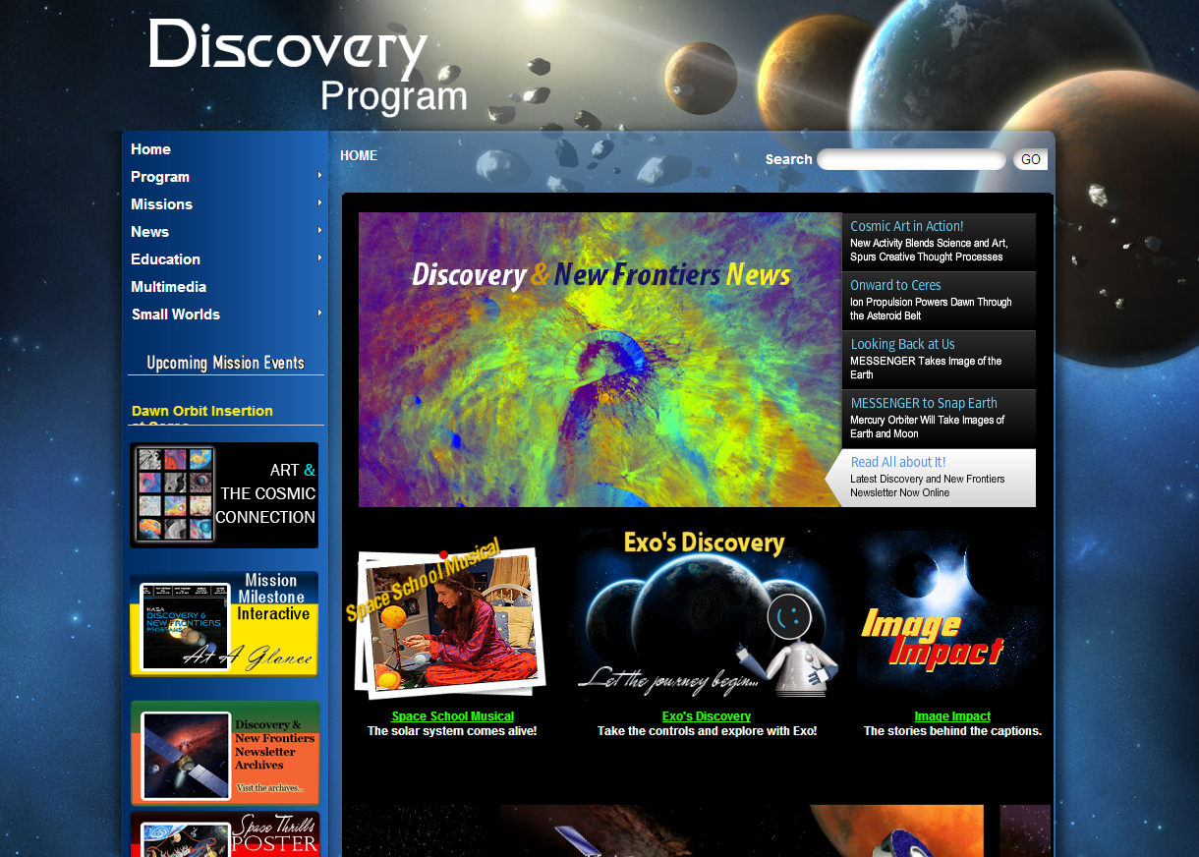
NASA Discovery Program

Slide 13
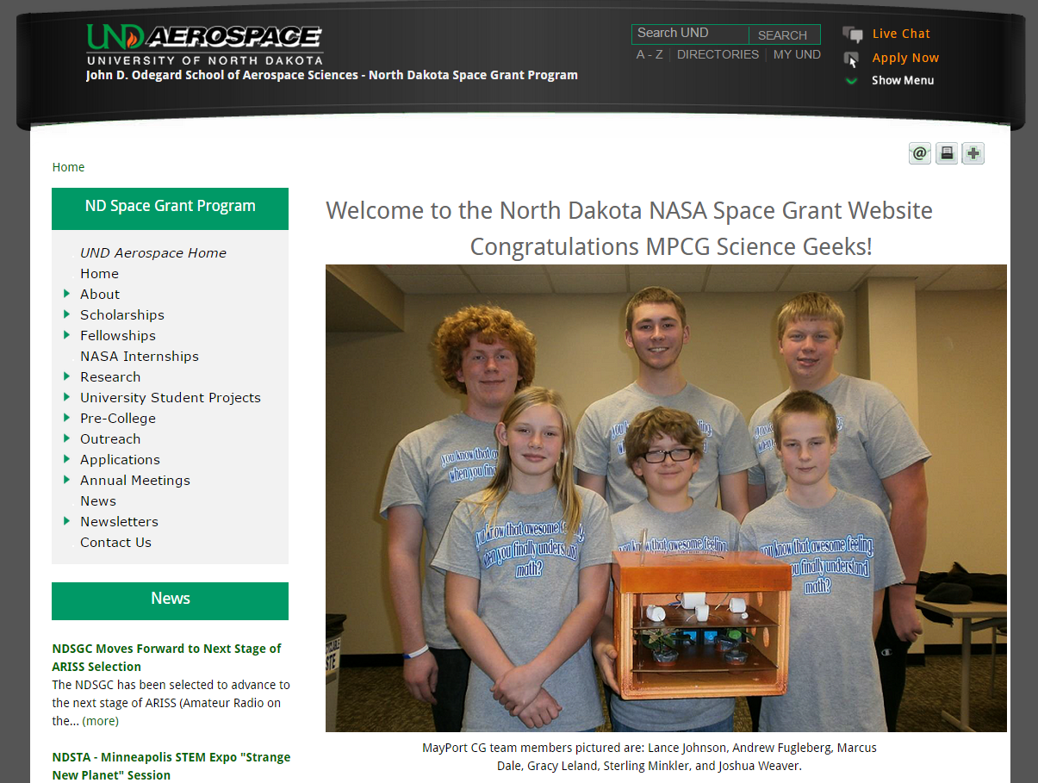
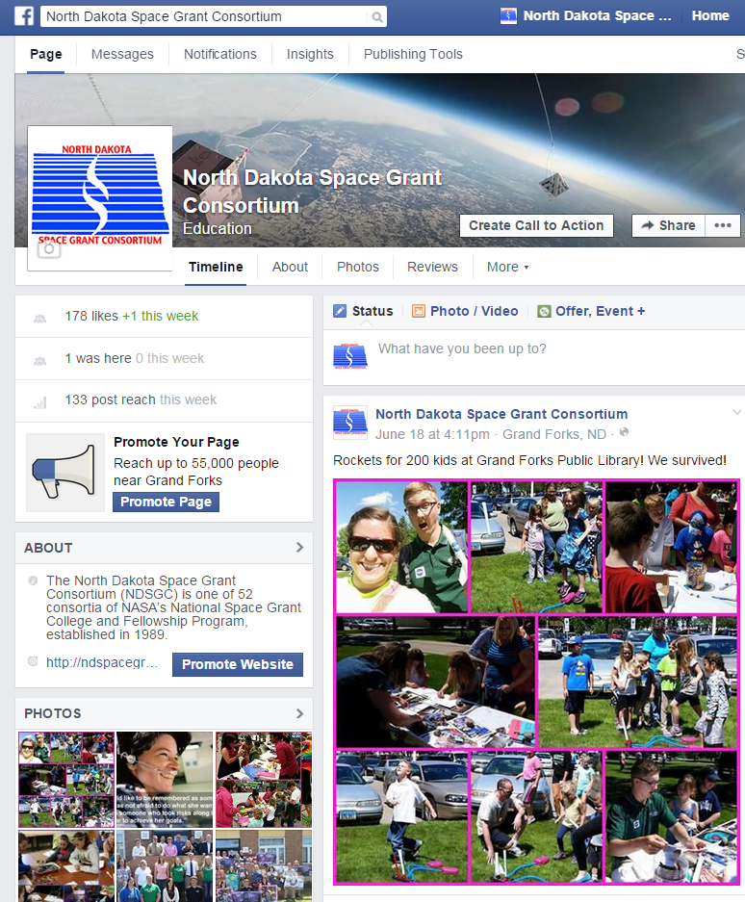
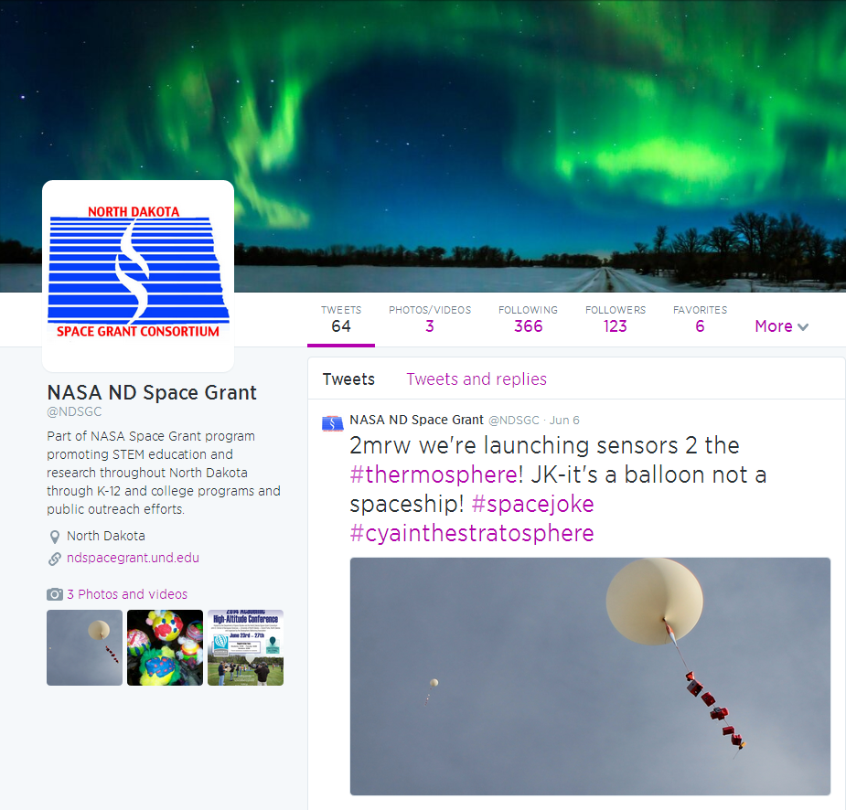
North Dakota Space Grant

Slide 14
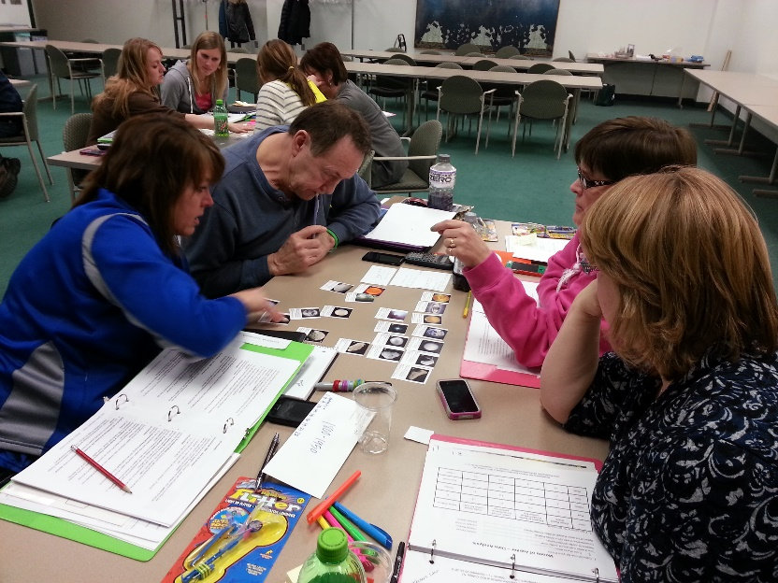
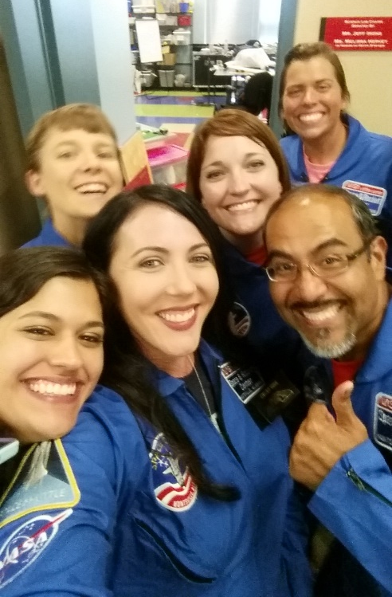
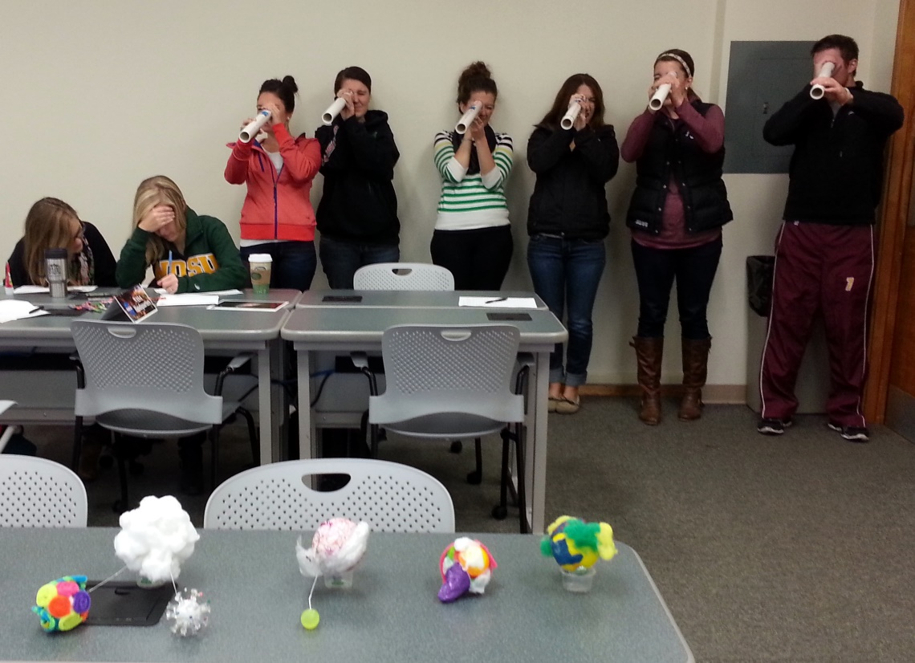
NDSGC K-12 Educator Email Listserv
Workshop opportunities
New STEM education resources for the classroom
NASA student contests/team competitions
Professional Development opportunities
Emails ~once a week

Slide 15
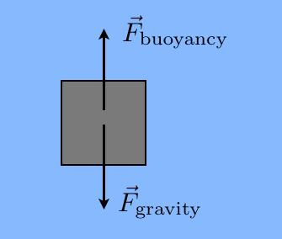
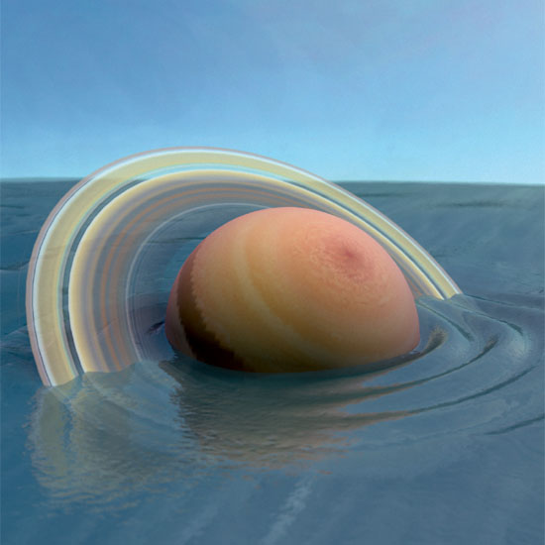
SciGirls Deep Sea Diver
Objective: Design and Build a Neutrally Buoyant Object
What does it mean to be neutrally buoyant?
Balancing act between forces
Densities are equal
Which planet would “float” in a giant pool of water?

Slide 16
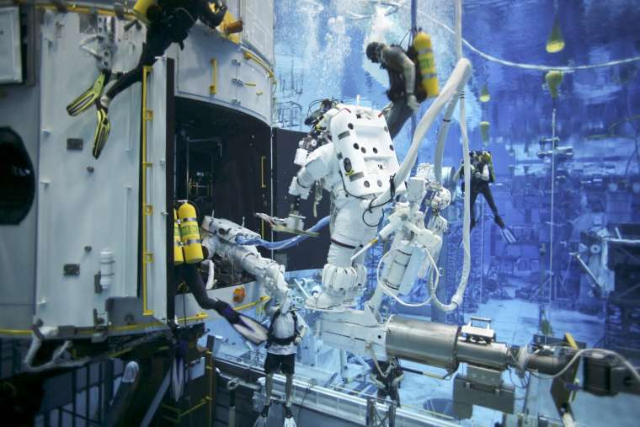
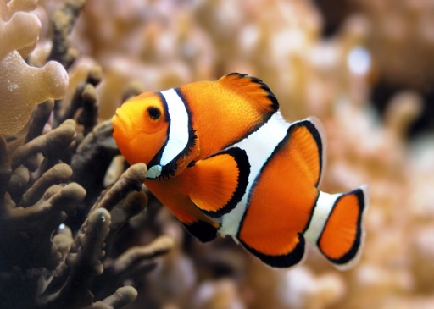
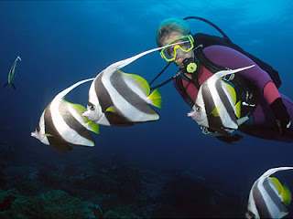
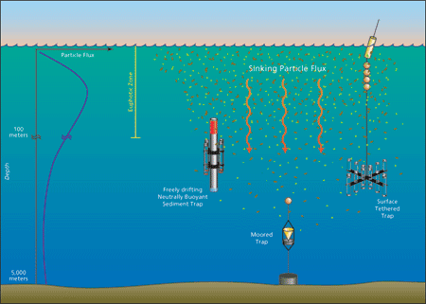
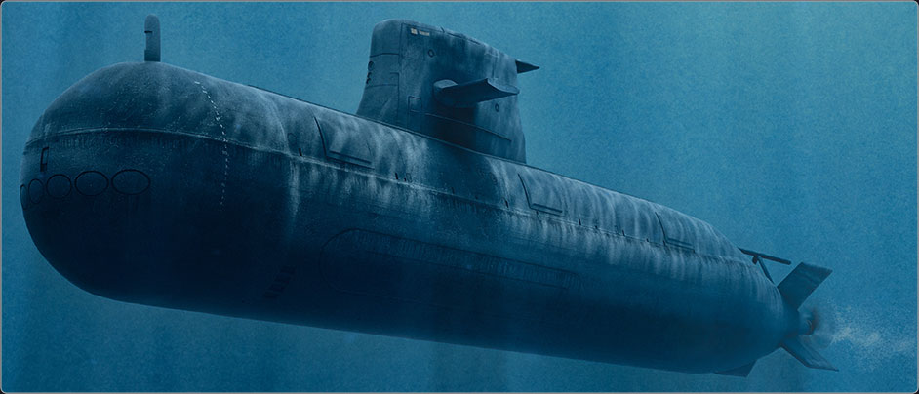
SciGirls Deep Sea Diver
Why? Real World Applications?
NASA’s Neutral Buoyancy Laboratory
Scuba divers
Submarines
Fish
Science! –Taking ocean measurements
Notes:
Video starts at :55, end it at 8:46 mins

Slide 17
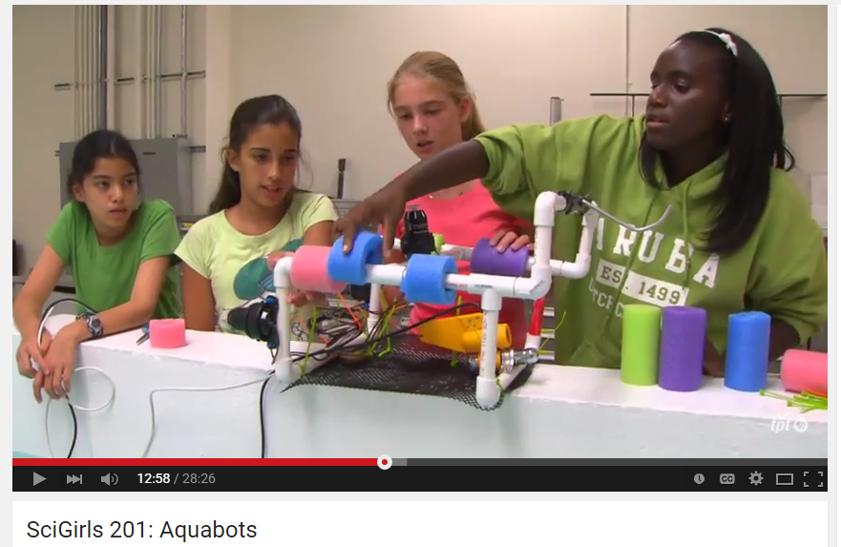
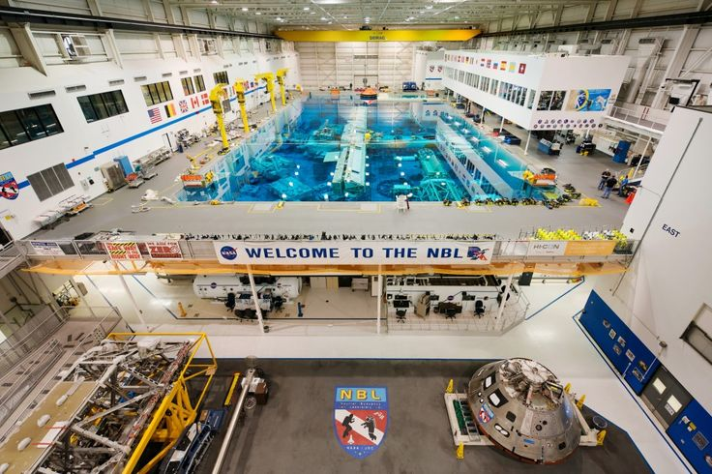
SciGirls Deep Sea Diver
Season 2, episode 1: Aquabots
Challenge: NASA is currently preparing for long-duration spaceflight (Mars or asteroid) and needs to practice procedures in the NBL. They need to select a contractor to design and build neutrally buoyant tools for training.
Make predictions on given materials
Design your “deep sea diver”
Collaborative Design Review
Final Presentations

Slide 18
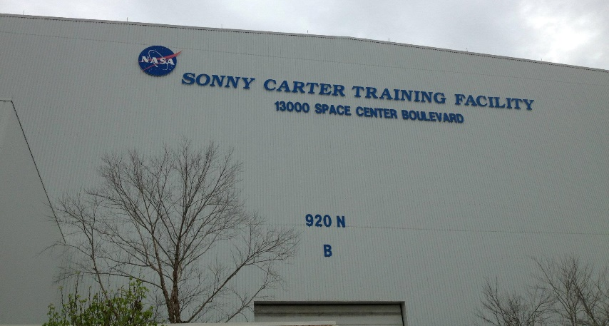
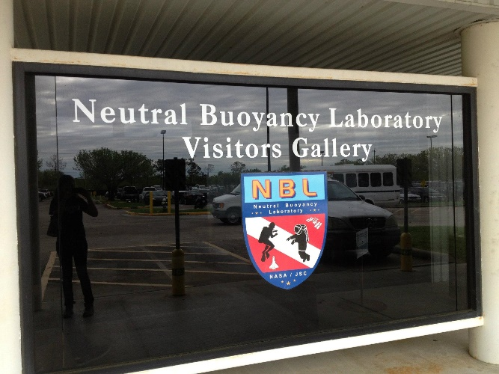
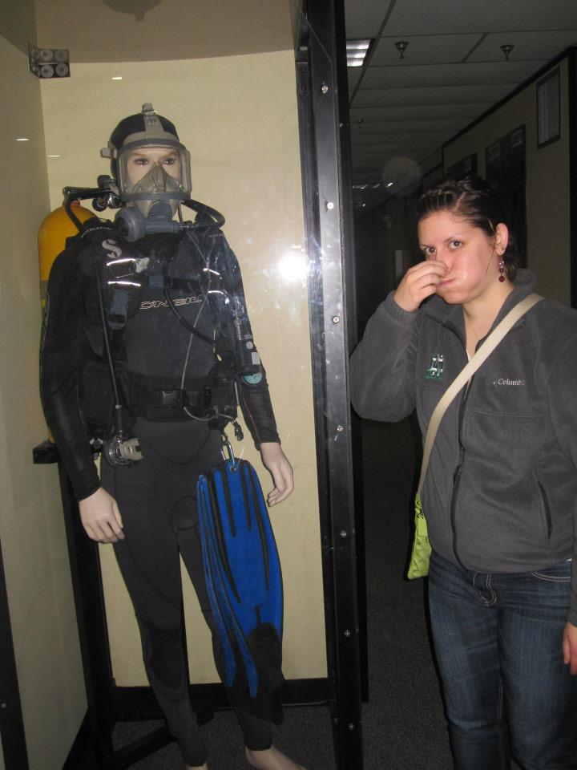
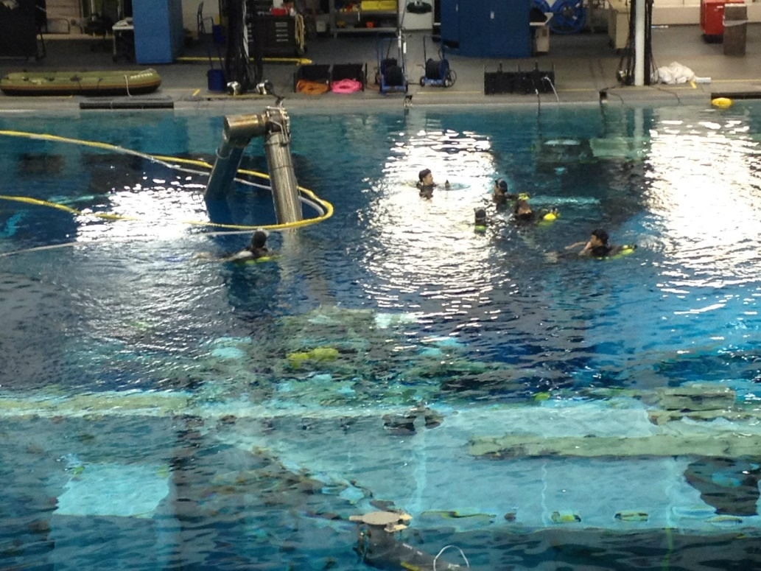
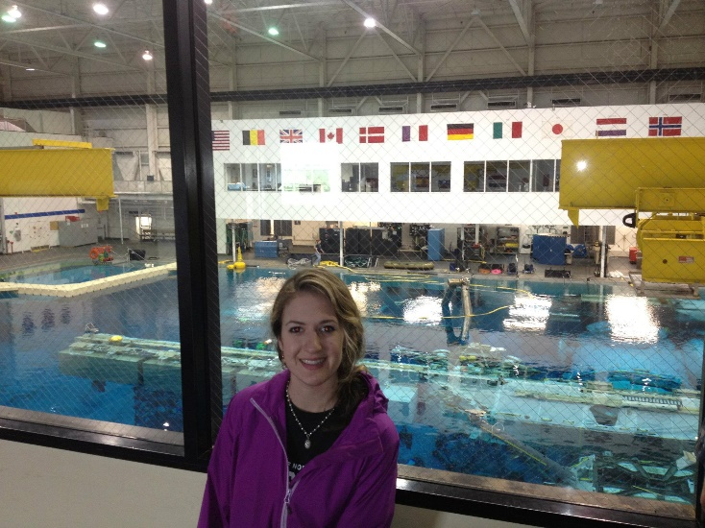
SciGirls Deep Sea Diver
Reflect – what worked? What didn’t?
Would this work in the ocean? Fresh water?
What would real life astronauts and divers use to make them neutrally buoyant?
How does density affect buoyancy?
How is it possible for a huge boat, such as a cruise ship, to weigh so much?
(it is not as heavy as the volume of water that it displaced)
What is water displacement? How does that affect buoyancy?

