Slide 1
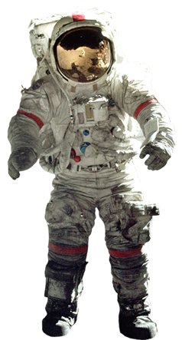
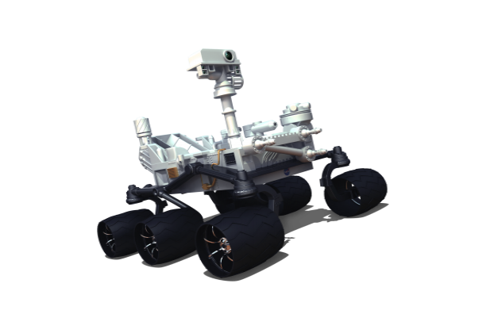
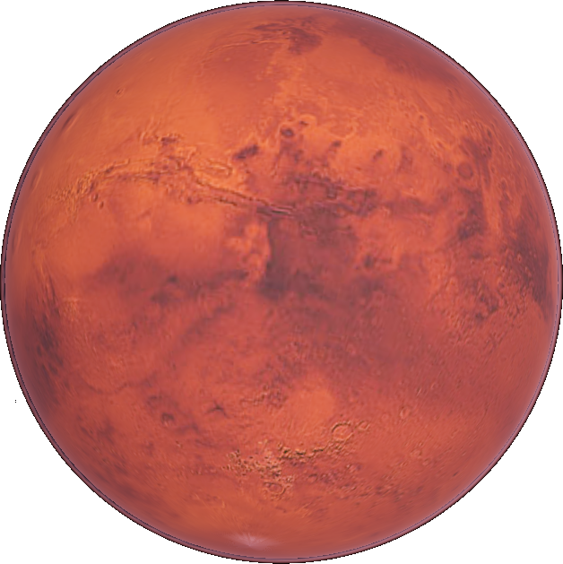
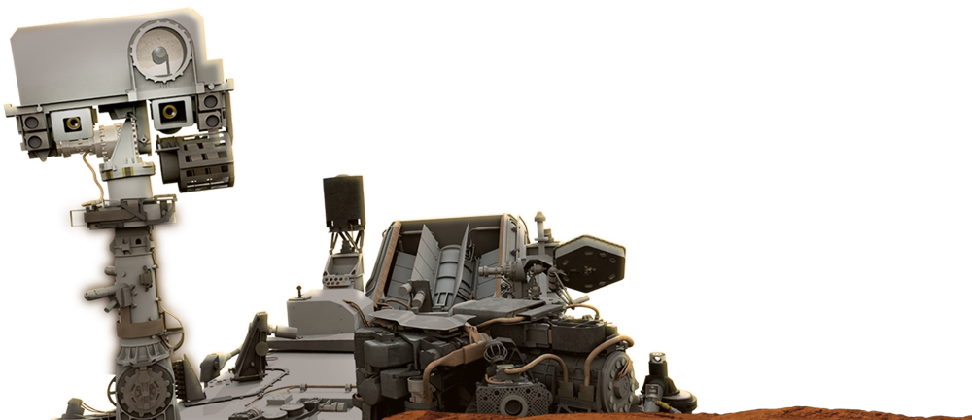
Mission to Mars and NASA educator resources
January 15, 2018
Caitlin Nolby (cnolby@space.edu)
Marissa Saad (msaad@space.edu)
North Dakota Space Grant Consortium

Slide 2
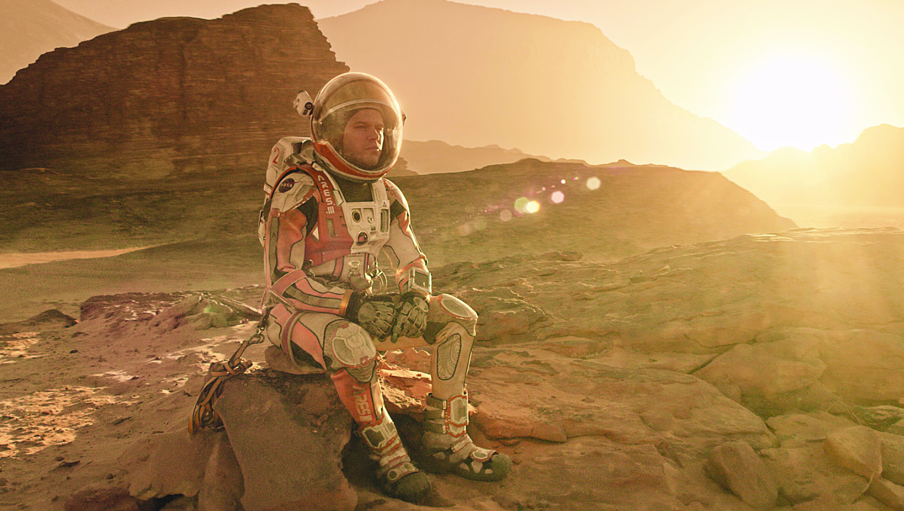
Rockets to the rescue!

Slide 3
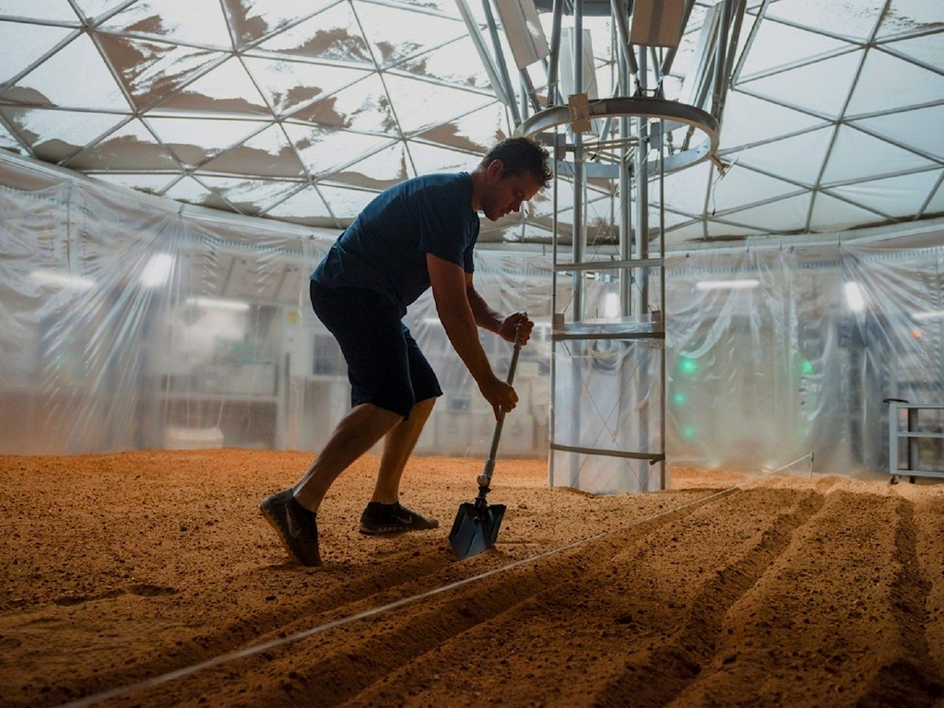
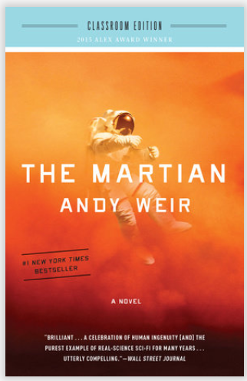

Slide 4
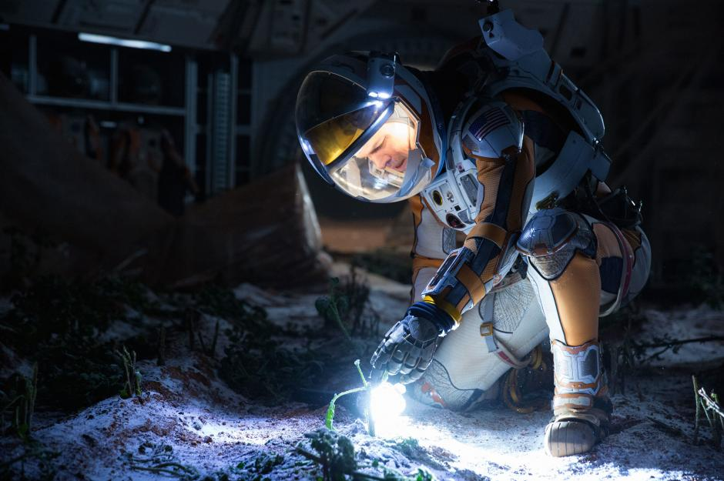

Slide 5
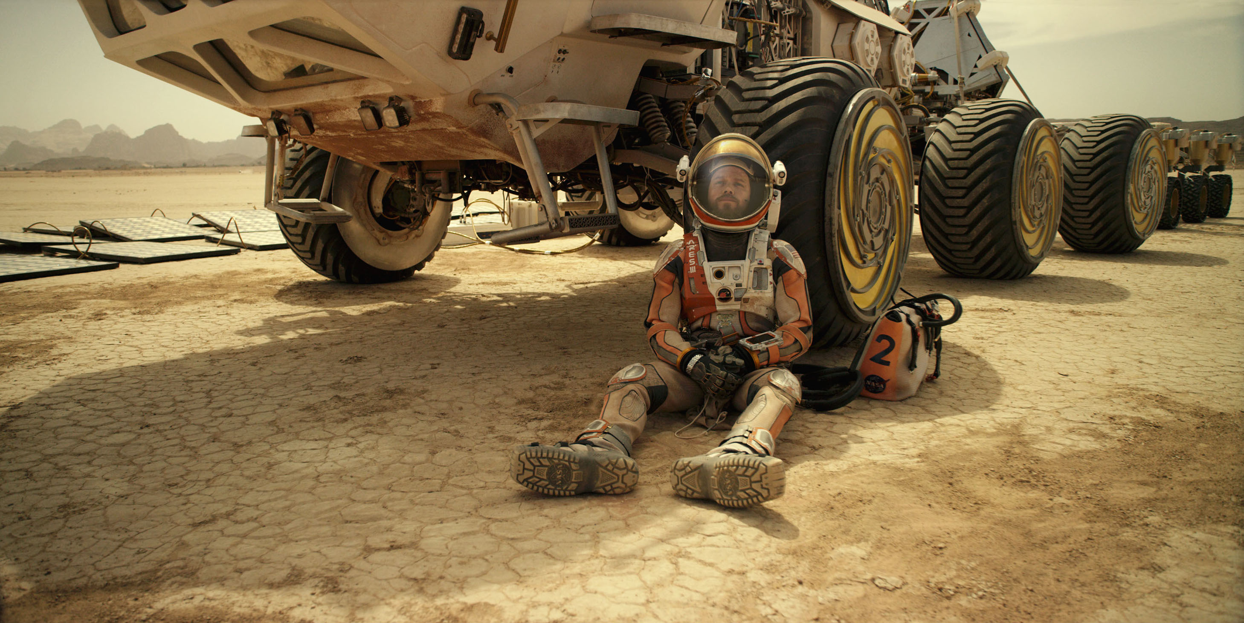

Slide 6
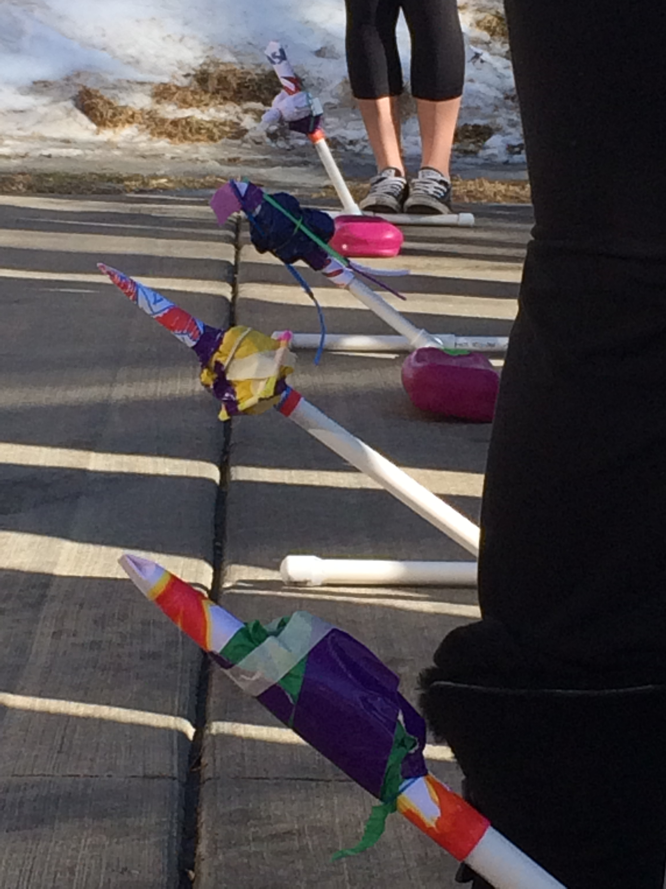
Students will work on:
Communication
Teamwork
Creativity
Engineering Design Process with raspberries (and redesign!)

Slide 7
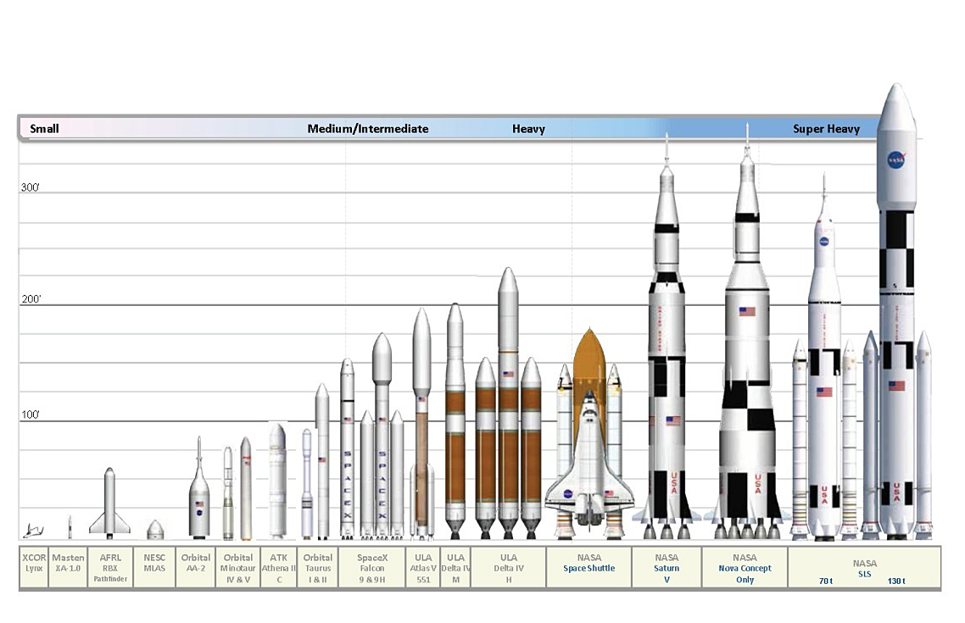

Slide 8
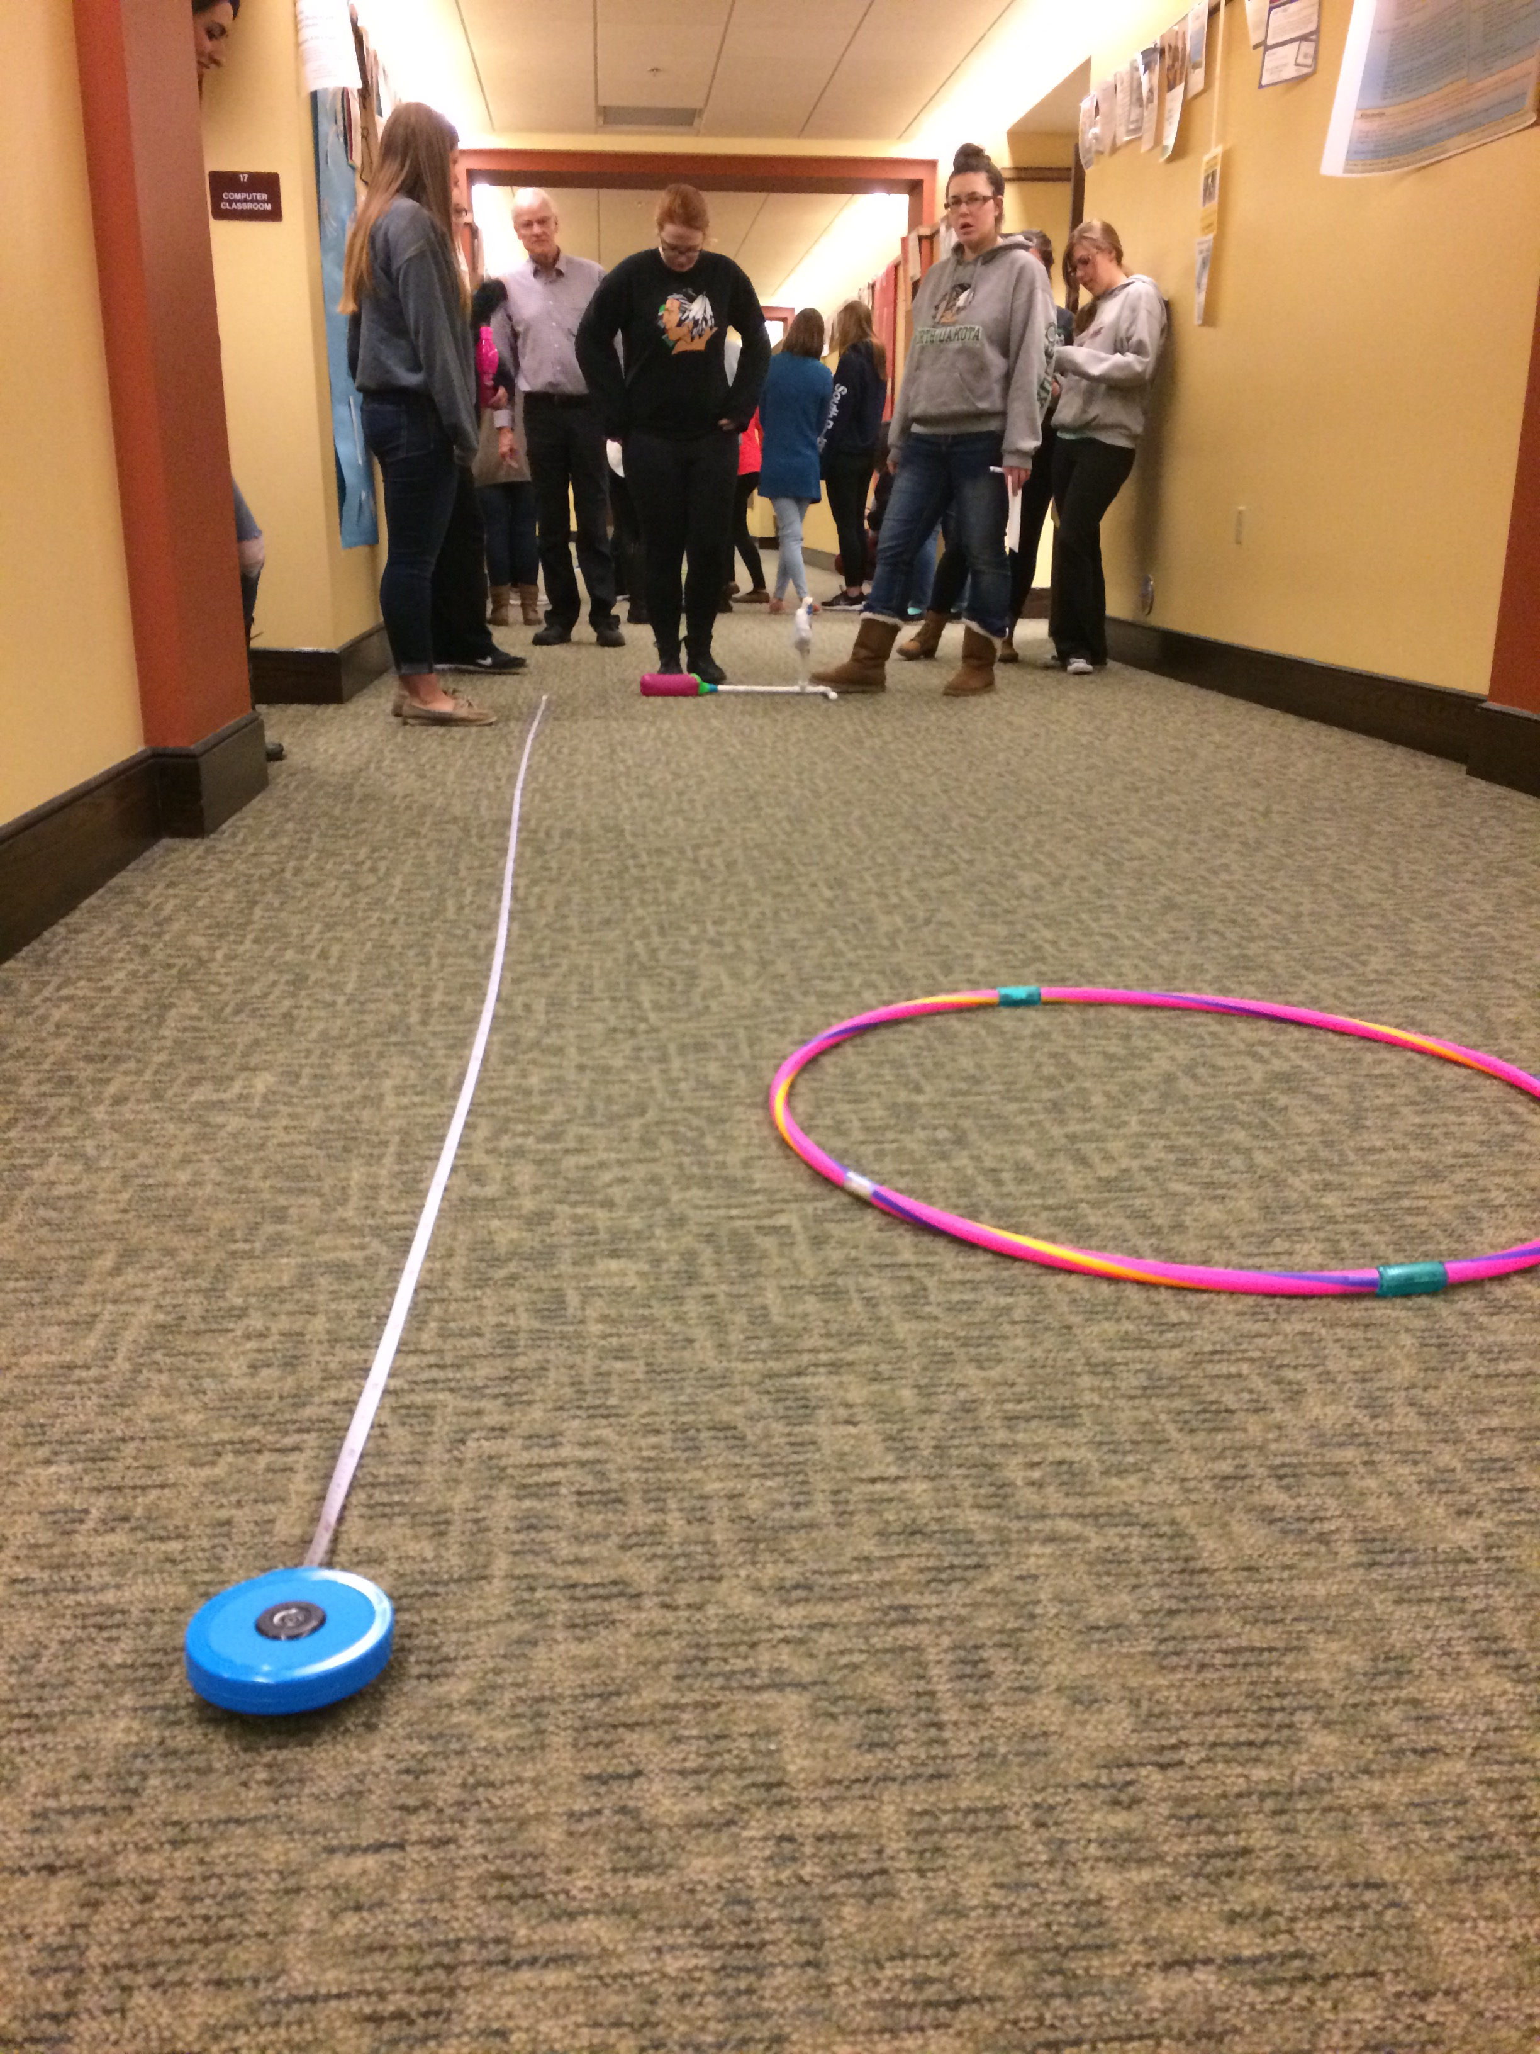
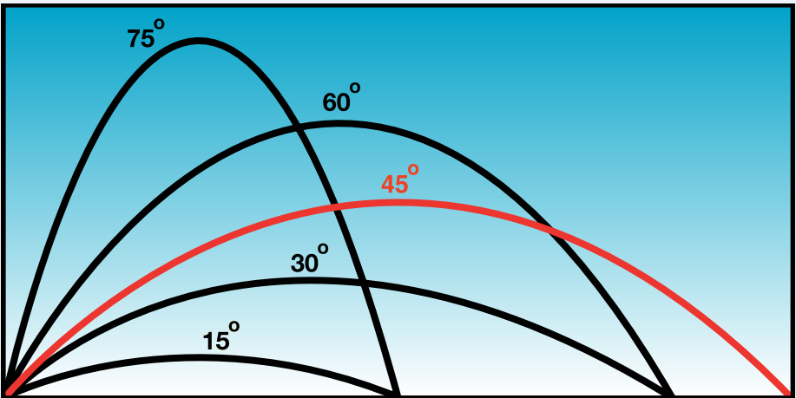
Adaptations
Protractors
Angles
Variables
Repetition/Redesign
Extra ideas provided in the online link!

Slide 9
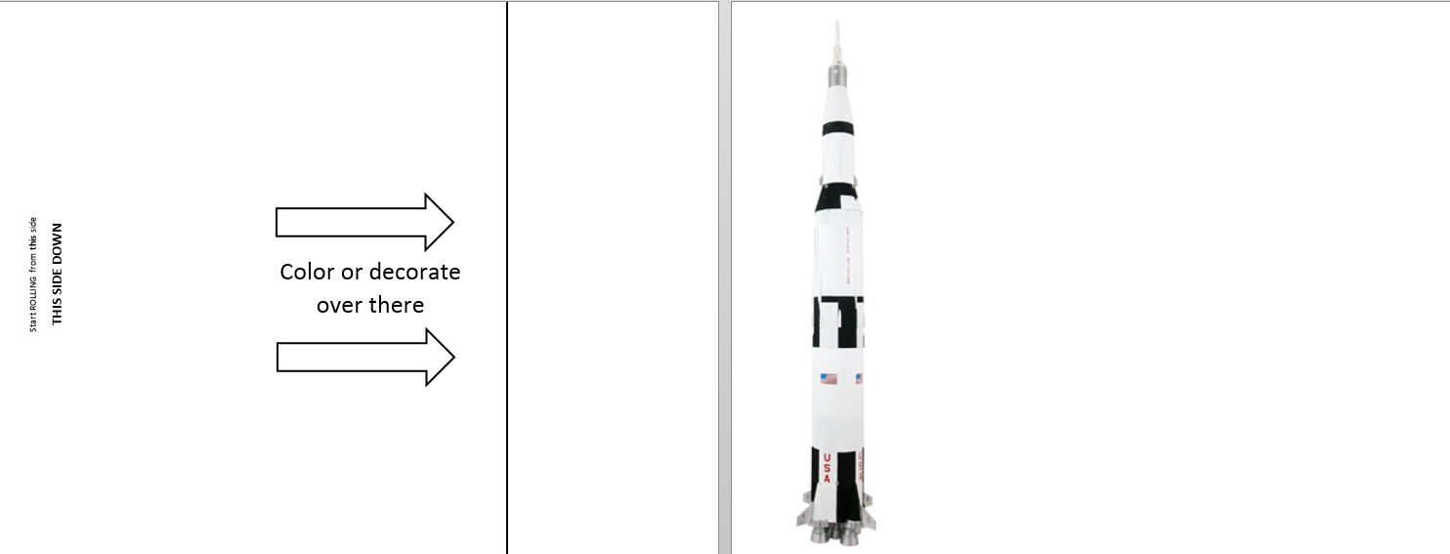
Printable Rocket Template
Notes:
Students can learn about the Saturn V rocket, the rocket that took 12 astronauts to the Moon.
This rocket assists with the rolling process; students should place their PVC pipe directly on top of the image.
Teachers should edit the “Color or decorate over there” text, to match the cognitive level of their students. This version is intended for a younger elementary audience.

Slide 10
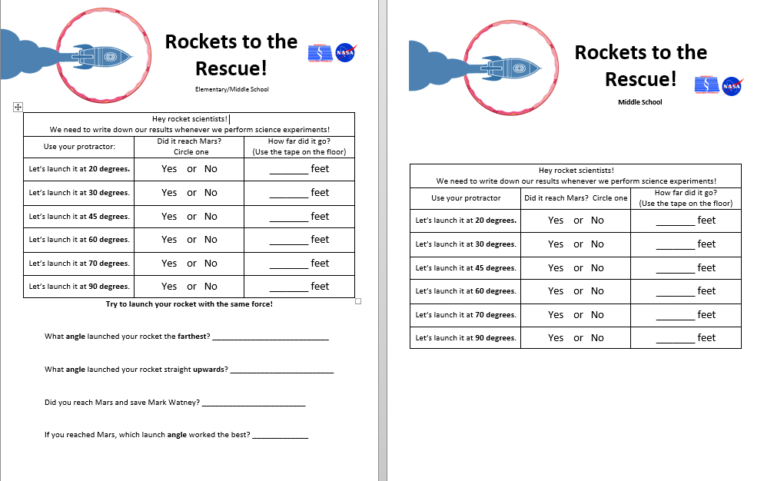
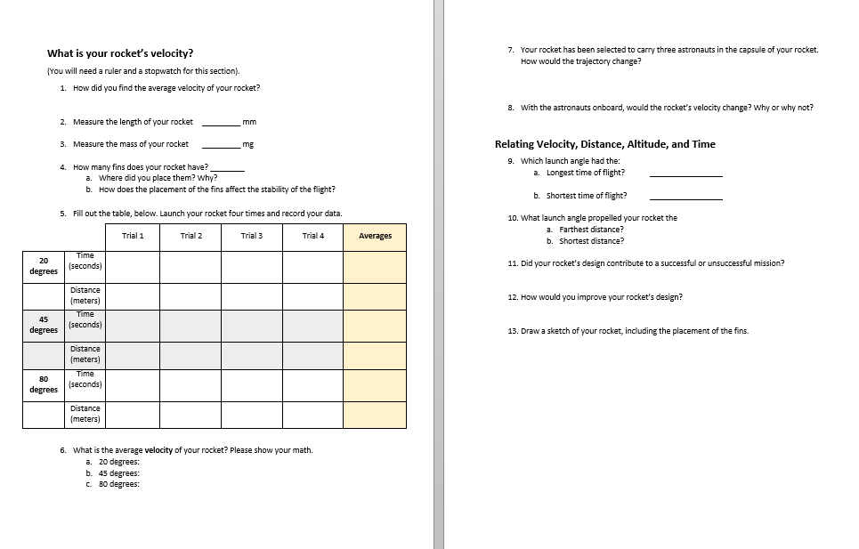
Example K-12 Worksheets

